Slide 1
Robotics Project Presentation Sprint 4
Robert Hart, Isaiah Bishop, Anthony Cross, and Khadar Estime

Slide 2
Challenges...
Our Group faced challenges such as:
  Group member availability
  Perfecting our code
  Practicing the Triathlon Course within HH208
  Did not have enough test runs before actual Triathlon test.

Slide 3
Roles...
Robert- Task Manager and a Code Tester
Isaiah- Coder for all Sprints
Anthony- Created all the FlowCharts for Sprints
Khadar- Tested all codes for each Sprint

Slide 4
What we have learned...
Within this Software Engineering Project we have learned:
  Team effort and participation are very important within group work.
  Everyone within your team has to do their part in order to succeed.
  Software Engineering takes time, effort, patience, and a lot of trial and error.

Slide 5
What we would do differently...
Manage our time better.
More time working with our robot in HH208 on the Triathlon Course
Better Code makes for a better Triathlon Run.
More trial and error to get our robot to run the course more successfully.

Slide 6
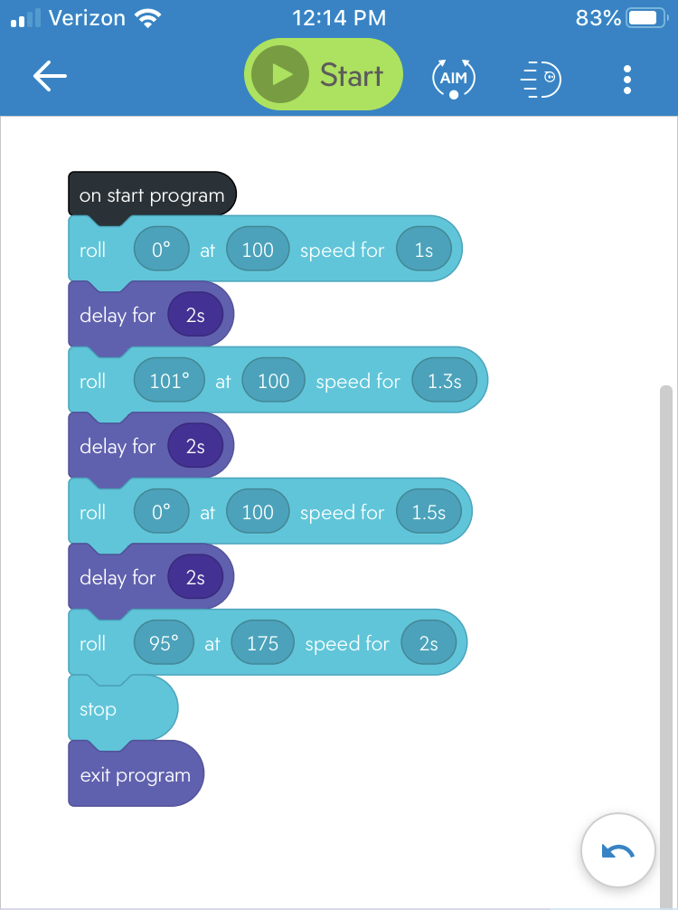
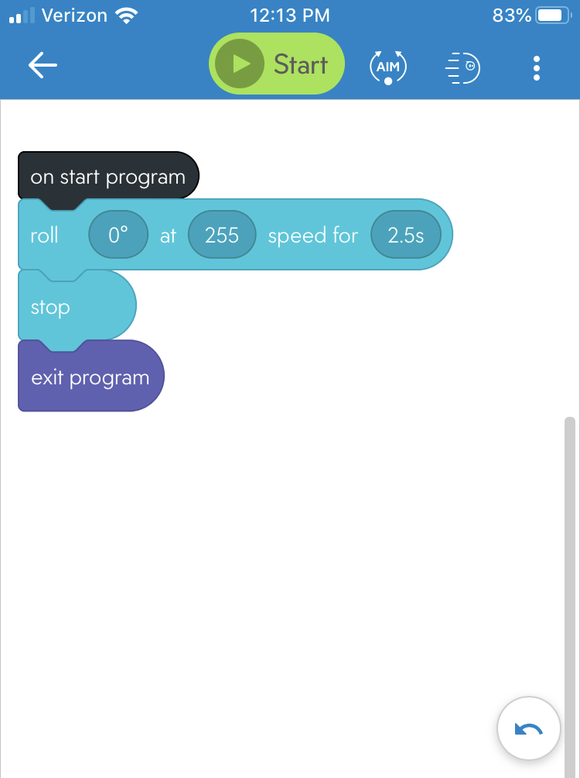
Code for Sprint 3 Agility...
Sprint 3 Part 1
Sprint 3 Part 2

